Slide 1






Object Oriented Analysis & Design
Engr. Abdul-Rahman Mahmood
DPM, MCP, QMR(ISO9001:2000)
armahmood786@yahoo.com alphapeeler.sf.net/pubkeys/pkey.htm pk.linkedin.com/in/armahmood www.twitter.com/alphapeeler www.facebook.com/alphapeeler
alphasecure@gmail.com http://alphapeeler.sourceforge.net http://alphapeeler.tumblr.com armahmood786@jabber.org alphapeeler@aim.com
abdulmahmood-sss alphasecure armahmood786@hotmail.com
http://alphapeeler.sf.net/me
mahmood_cubix s48660186 alphapeeler@icloud.com
http://alphapeeler.sf.net/acms/

Slide 2


Slide 3

Objectives
Concept of reflexive relationship
Concept of association class
Homogenization of the system
Why is homogenization required
Changing the class model through homogenization
Case study for homogenization
What are components and why we need them

Slide 4







Concept of reflexive relationship
A class can have a self association. reflexive relationship
Class
a staff working in an airport may be a pilot, aviation engineer, a ticket dispatcher, a guard, or a maintenance crew member.

Slide 5











Concept of association class
Associations can also be objects themselves, called link classes or an
association classes.
Registration
modelNumber serialNumber warrentyCode
Product
Warranty

Slide 6

Homogenization of the system
 In parallel design process, several stimuli with the same purpose or meaning are defined by several designers. These stimuli should be consolidated to obtain as few stimuli as possible. It is called homogenization.
 Homogenize - to change (something) so that its parts are the same or similar.

Slide 7

Why is homogenization required
If different teams are working on different scenarios, a class may be called by different names.
These name conflicts must be resolved.
Homogenization is an ongoing process.

Slide 8

Elements of Homogenization
COMBINING CLASSES
SPLITTING CLASSES
ELIMINATING CLASSES
SCENARIO WALK THROUGH
EVENT TRACING
DOCUMENTATION REVIEW

Slide 9

Homogenization
COMBINING CLASSES
examine each class with its definition.
Examine attributes and functions of the classes.
Look for the use of synonyms.
Once you determine that the 2 classes are doing the same thing, choose the name that is closest to the language used by the customer.

Slide 10

Homogenization
SPLITTING CLASSES
Classes should be examined if they are following the golden rule of OO, that is A class should do one thing and it should do really well.
Example :
A StudentInformation class contains:
Info about student Actor
And info about the courses that student has successfully completed.
Resolve into 2 classes: StudentInfo and Transcript.

Slide 11

Homogenization
ELIMINATING CLASSES
When?
A class does not have any structure or behavior
The class does not participate in any use cases
Guideline: Look for the control classes in particular. Lack of the sequencing responsibility may lead to the deletion of the class.
Example:
A control class is only a pass through or a forwarder. I.e., it received information from boundary class and only passes it to the entity class without the need of sequencing logic.

Slide 12

Homogenization
CONSISTENCY CHECKING
Why ?
Because static view of the system and dynamic view of the system and interaction view of the system are under development in parallel.
Consistency checking is necessary to check if all the 3 views of the system has the same assumptions / decisions and terminology used.
Consistency Checking is done by forming a small team.
Team members 5-6.
Analyst, Designer, Customer / Customer Rep., Domain experts.

Slide 13

Homogenization
SCENARIO WALK THROUGH
A simple method of consistency checking is walk through of high risk scenario as represented by sequence / collaboration diagrams.
Specially check the reflexive relationships because they are likely to miss during analysis.
Reflexive relationships are needed when multiple objects of the same class interacts during a single scenario.
Finally verify that each object in sequence / collaboration diagram belongs to a class on the class diagram.

Slide 14

Homogenization
EVENT TRACING
For every message on the sequence / collaboration diagrams:
Verify that an operation is responsible to send the message in the sending class
Verify that an operation is responsible to receive the
message in the receiving class and handles it properly.
Verify that there exists some kind of association between sending and receiving classes on the class diagram.
Verify each message in the state transition diagram.

Slide 15

Homogenization
DOCUMENTATION REVIEW
Each class should be documented.
Verify that each method and attribute is defined properly.
Finally check for the establishment of documentation standards, format specifications, and content rules.
Make sure that all the standards established are followed.

Slide 16

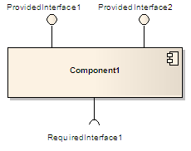

Component (UML)
 A component in the Unified Modeling
Language "represents a modular part of a system, that encapsulates its content and whose manifestation is replaceable within its environment. A component defines its behavior in terms of provided and
required interfaces".^{[1]}
Manifestation : an event, action, or object that clearly shows or embodies something abstract or theoretical.

Slide 17

Component (UML)
A component may be replaced by another if and only if their provided and required interfaces are identical.
This idea is the underpinning for the plug-and- play capability of component-based systems and promotes software reuse.
UML places no restriction on the granularity of a component. Thus, a component may be as small as a figures-to-words converter, or as large as an
entire document management system.
Such assemblies are illustrated by means of component diagrams.

Slide 19

Implementation Diagrams
Both are structural diagrams
Component Diagrams:
set of components and their relationships
Illustrate static implementation view
Component maps to one or more classes, interfaces, or
collaborations
Deployment Diagrams:
Set of nodes and their relationships
Illustrate static deployment view of architecture
Node typically encloses one or more components

Slide 20

Package
General purpose mechanism for organizing elements into groups
Can group classes or components.
Package Name

Slide 21


Component Diagram
Classes
Interfaces
Dependency, generalization, association, and realization relationships
Example.java
Special kind of class diagram focusing on system’s components.

Slide 22

Interfaces
Definition:
Collection of operation signatures and/or attribute defns
Defines a cohesive set of behaviors
Realized by:
Implemented by classes and components
Implement operations/attributes defined by interface
Relationships:
A class can implement 0ne or more interfaces
An interface can be implemented by 1 or more classes
Notation:
Lollipop
Dashed arrow

Slide 23

UML Component Diagrams
Component diagram shows components, provided and required interfaces, ports, and relationships between them. This type of diagrams is used
in Component-Based Development (CBD) to describe systems with Service-Oriented Architecture (SOA).
Component-based development is based on assumptions that previously constructed components could be reused and that components could be replaced by some other "equivalent" or "conformant" components, if needed.

Slide 24

UML Component Diagrams
Component are intended to be capable of being deployed and re-deployed independently, for instance to update an existing system.
Components in UML could represent
logical components (e.g., business components, process components), and
physical components (e.g., CORBA components, EJB components, ATL, COM+ and .NET components, WSDL (Web Service Definition Language) components, etc.),

Slide 25

Online Shopping - Components
Summary: The diagram shows "white-box" view of the internal structure of three related subsystems: WebStore, Warehouses, and Accounting.
WebStore subsystem contains three components related to online shopping - Search Engine, Shopping Cart, and Authentication.
Accounting subsystem provides two
interfaces: Manage Orders and Manage Customers.
Warehouses subsystem provides two interfaces: Search Inventory and Manage Inventory used by other subsystems.

Slide 26

Online Shopping - Components
WebStore subsystem contains three components related to online shopping - Search Engine, Shopping Cart,
and Authentication.
Search Engine component allows to search or browse items by exposing provided interface Product Search and
uses required interface Search Inventory provided by Inventory component.
Shopping Cart component uses Manage
Orders interface provided by Orders component during checkout.
Authentication component allows customers to create account, login, or logout and binds customer to some account.
Accounting subsystem provides two interfaces - Manage Orders and Manage Customers.

Slide 27

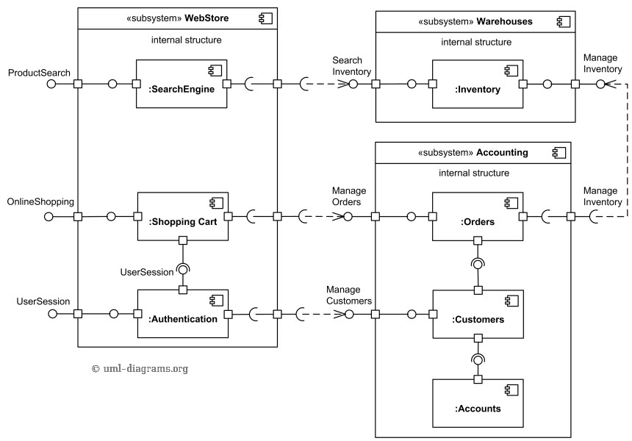
Ex1: Component Diagram

Slide 28

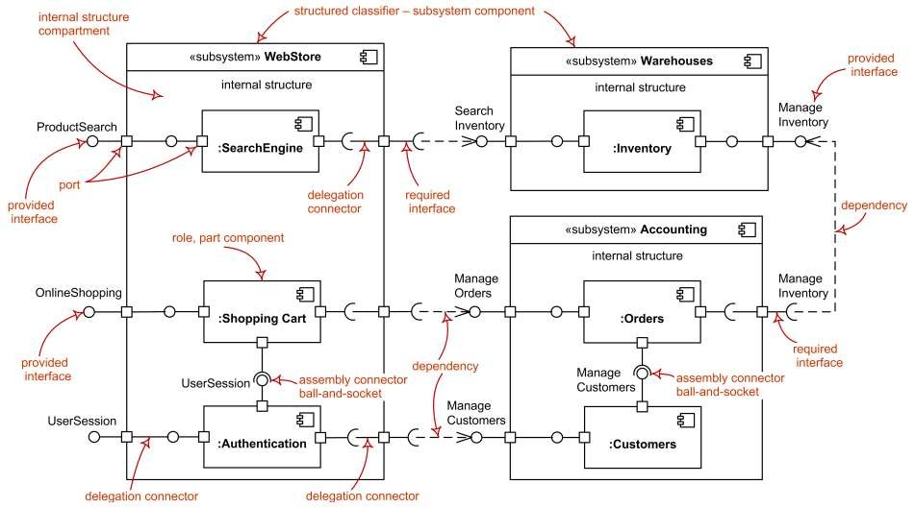
Ex1: UML Component Diagram

Slide 29

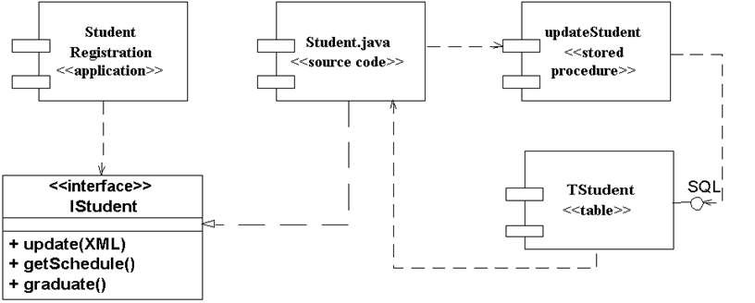
Ex2: Sample interfaces

Slide 30

Online ordering / shipping
Online Ordering and Shipping applications uses Apache Struts framework forMVC. There isa Customer componentwhich provides XML (data) and ICustomer interfaces. There isan Orders componentwhich provides XML (data) and IOrderinterfaces.
Ordering Appuses IOrder & ICustomer interfaces toplaceorders. Shipping Apprequires XML data from Customer component & uses IOrderto link respectiveorders forshipping.
Security infrastrure provides IAccesControl & IEncryption interfaces. IAccesControl isused by Ordering, Shipping, Customers and Orders.
Persistence infrastructure hasa dependency on CorporateDB componentvia JDBC. Persistence infrastructure provides IPersistence used by Customers and Ordersto providestorage persistency for customerorders.

Slide 31

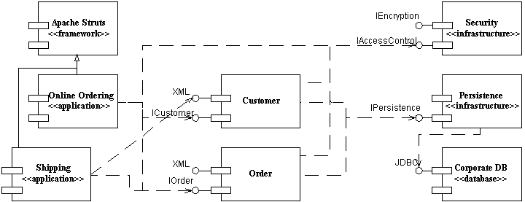
Ex3: Component Diagram

Slide 32

Ex4: Component Diagram
Consider a scenario of a web application where initially customer visits index.html page and from there he has two options: (1) select a category then goto find.html page to search in that category (2) or he can directly jump to the find.html page for direct product search without category. find.html uses Find.exe application, which in-turn uses a Products DLL with static binding and Categories with dynamic binding.
DLL (Dynamic Link Library) , a library of executable functions or data that can be used by a Windows application. Typically, a DLL provides one or more functions and a program can accesses functions by creating either a static or dynamic link to DLL. Static link remains constant during program execution while a dynamic link is created by the program as needed.

Slide 33












Ex4: Component Diagram
executable
find.html
Find.exe
page
Index.html
Dynamic Link
Static Link
Library Package
Category.dll
Products.dll
library

Slide 34

Common Uses:
Model source code:
model configuration mgmt
Model executable releases
Release is relatively complete and consistent set of artifacts delivered to user
Release focuses on parts necessary to deliver running system
Component Diagram visualizes, specifies, and documents the decisions about the physical parts that define the software.

Slide 35

Common Uses: (cont’d)
Model Physical databases:
Component Diagram can represent physical DBs
database is concrete realization of schema
schemas offer an API to persistent information
model of physical DBs represents storage of information in tables of a relational DB or pages of an OO dbase.
Model Adaptable systems:
Adaptable Models support changeable domain modules.
Allow users to add new rules / features to system without new programming.
can model static aspects of adaptable systems
can model dynamic aspects (in conjunction with behavioral models)

Slide 36

Modeling Source Code
(Forward/Reverse Eng): identify set of source code files of interest
 model as components stereotyped as files
Larger systems: use packages to show groups of source code files
Model compilation dependencies among files

Slide 37










Ex5: Modeling Source Code
Signal.h
{version=3.5}
Signal.h
{version=4.0}
Signal.h
{version=4.1}
5 source code files
signal.h (header)
used by 2 other files (signal.cpp, interp.cpp)
interp.cpp has compilation dependency to header file (irq.h)
device.cpp compilation dependency to interp.cpp
<<parent>>
Interp.cpp
<<parent>>
Signal.cpp
Irq.h
Device.cpp

Slide 38

Ex6: Communication Links
 Communication associations support one or more communication protocols, each of which should be indicated by a UML stereotype. In Figure you see that the HTTP, JDBC, and web services protocols are indicated using this approach.

Slide 39

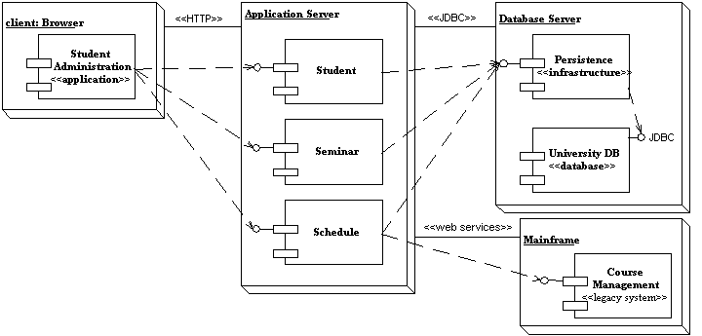
Ex6: Communication Links

Slide 40

Common stereotypes for communication associations.
Asynchronous: An asynchronous connection, perhaps via a message bus or message queue.
HTTP: HyperText Transport Protocol.
JDBC: Java Database Connectivity, Java API for DB access.
ODBC: Open Database Connectivity, (MS API for DB).
RMI: Remote Method Invocation, (Java comm. Protocol).
RPC: Communication via remote procedure calls.
Synchronous: A synchronous connect where the senders waits for a response from the receiver.
web services: Communication is via Web Services protocols
such as SOAP and UDDI

Slide 41

Component Diagram Guidelines
Use Descriptive Names for Architectural Components
Use Environment-Specific Naming Conventions for Detailed Design
Components
Apply Textual Stereotypes to Components Consistently
Avoid Modeling Data and User Interface Components
Interfaces
Prefer Lollipop Notation To Indicate Realization of Interfaces By
Components
Prefer the Left-Hand Side of A Component for Interface Lollipops
Show Only Relevant Interfaces
Dependencies and Inheritance
Model Dependencies From Left To Right
Place Child Components Below Parent Components
Components Should Only Depend on Interfaces
Avoid Modeling Compilation Dependencies

Slide 42



































Common Stereotypes
Stereotype
<<application>>
ASP/JSPs
screens and
<<database>> database.
<<document>>
<<executable>> stereotype.
<<file>>
<<infrastructure>>
<<library>>
<<source code>>
<<table>>
<<web service>>
<<XML DTD>>
Indicates
A “front-end” of your system, such as the collection of HTML pages and
that work with them for a browser-based system or the collection of controller classes for a GUI-based system.
A hierarchical, relational, object-relational, network, or object-oriented
A document. A UML standard stereotype.
A software component that can be executed on a node. A UML standard
A data file. A UML standard stereotype.
A technical component within your system such as a persistence service or an audit logger.
An object or function library. A UML standard stereotype.
A source code file, such as a .java file or a .cpp file.
A data table within a database. A UML standard stereotype One or more web services.
An XML DTD.

Slide 43


Slide 44

Deployment Diagram
Shows the configuration of:
run time processing nodes and
the components that live on them
Graphically: collection of vertices and arcs

Slide 45

Contents
Deployment diagrams contain:
Nodes
Dependency and association relationships
may also contain components, each of which must live on some node.

Slide 46












A Deployment Diagram
Internet
node Modem bank
<<processor>>
Caching server
<<processor>>
Caching server
connection
<<network>> local network
<<processor>> primary server
<<processor>>
<<processor>>
<<processor>>
server
server
server

Slide 47

Modeling Client-Server Architecture
Identify nodes that represent system’s client and server processors
Highlight those devices that are essential to the behavior
 E.g.: special devices (credit card readers, badge readers, special display devices)
Use stereotyping to visually distinguish

Slide 48

















Client-Server System
Human resource system
2 pkgs: client, server
Client: 2 nodes
console and kiosk
stereotyped, distinguishable
Server: 2 nodes
caching server and server
Multiplicities are used
client
console
kiosk
server
2..*
<<processor>>
Caching server
Deploys
Http.exe rting.exe
4..*
<<processor>> server
Deploys
dbadmin.exe tktmstr.exe logexc.exe

Slide 49

Guidelines for Deployment Diagrams
General [Ambler 2002-2005]
Indicate Software Components on Project-Specific
Diagrams
Focus on Nodes and Communication Associations on Enterprise-Level Diagrams
Nodes and Components
Name Nodes With Descriptive Terms
Model Only Vital Software Components
Apply Consistent Stereotypes to Components
Apply Visual Stereotypes to Nodes
Dependencies and Communication Associations
Indicate Communication Protocols Via Stereotypes
Model Only Critical Dependencies Between Components

